Slide 1
Introduction to EEG and independent component analysis
BME 517

Slide 2
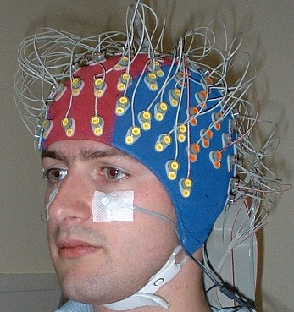
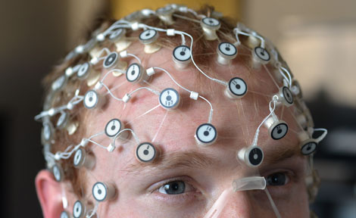
Electroencephalography (EEG)
Gelled electrodes on scalp
High-density (128 channels)

Slide 3
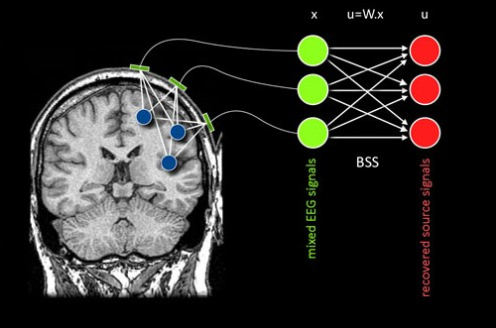
Independent component analysis (ICA)
Use ICA to find sources in brain

Slide 4
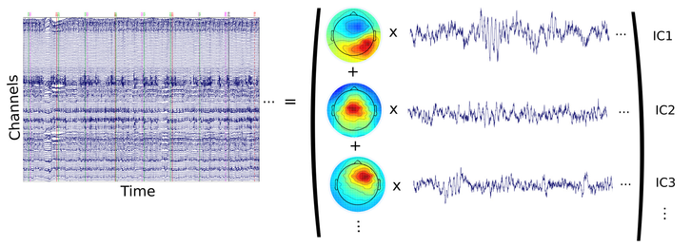
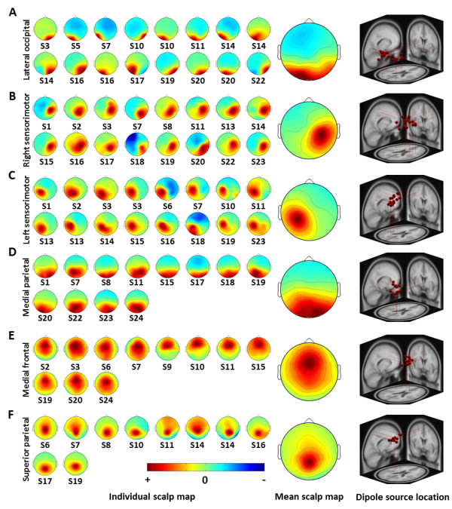
Scalp maps
Map channels to independent components
Correspond to locations on head

Slide 5
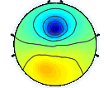
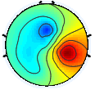
Example scalp maps
Find maximum magnitude (use contours on plot)

Slide 6
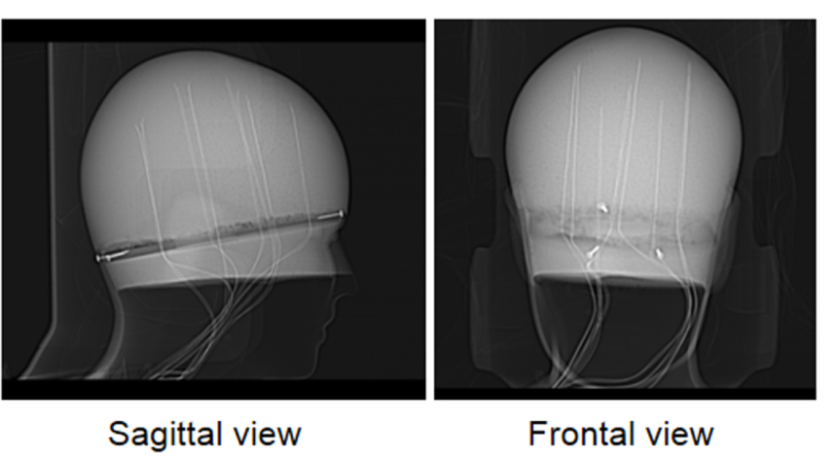

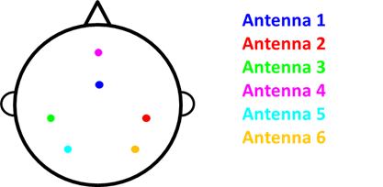
Phantom Head
Used for ground-truth testing

